Slide 1

Team: Mitigating Scavengers
Minal Bhavnani
Akshara
Anurag Dhar
Sai Swaroop Reddy
Satwik Kashyap
Anjaneya Naik

Slide 2
Index
Industry and Company
Background of Auditee and Auditor
Services as Capital Jones
Policies and Procedures at Capital Jones
Executive Statement
Organizational Chart
AWS Architecture
Network Architecture
Audit Approach and Planning
Findings and Recommendations
Conclusion of this Audit

Slide 3
Industry and Company
Industry: Finance and Insurance
PCI Audit
Company Name: Capital Jones
Creation Date: 1/1/2013
Number of Employees: 500

Slide 4
Background – Business
Capital Jones have the comprehensive suite of banking and insurance services you need to turn your goals into reality. Customers pf Capital Jones have all the A grade services including mobile banking and a very prompt in bank services. Partnering with this financial advisor, you can build a diversified portfolio from a broad universe of quality investments, bonds, mutual funds and ETFs, while their insurance and annuity products can help to protect your financial future. And if you have specific wealth strategies, trust management or business ownership needs, our convenient financial services offer the professional administration options you're looking for

Slide 5
Background- Auditor Company
Johnson Yang was formed in 2006 in the Washington, DC area by Larry Johnson and Debbie Lambert. Currently headquartered at NC with an employee size of 200.
It is a niche-focused CPA firm that provides audit, tax, and business advisory services to a nationwide client base of Financial entities, not-for-profits, and employee benefit plans.

Slide 6
Service: Cash and Credit
Acting as payment agents by conducting checking or current accounts for customers
Paying cheques drawn by customers in the bank
Collecting cheques deposited to customers current accounts
Automated Clearing House (ACH)
Wire transfers
Telegraphic transfers
EFTPOS
ATMS

Slide 7
Standard Operating Procedures
Opening/Closing Account Procedures
ATM Visa Debit Card Procedure
Bank Wire Transfer Procedure
Foreign Currency Procedure
Incoming Outgoing Collections Procedure
Teller Transactions Procedure
Guard Force Management Procedure
Lost Stolen Checks NS Funds Procedure

Slide 8
Policies at Capital Jones
Overdraft Policy
Dormant Accounts Policy
Contingency Plan Policy
Fair Credit Reporting Act Policy
Identity Theft Prevention Policy
Anti-money Laundering Policy
Risk Management Policy

Slide 9
Executive Statement
Our audit covered a review of the management control framework in place to ensure compliance with any government policies as well as with all parties and vendors; also compliance with company’s own policies and procedures. Review was done to also make sure that departmental procedures are effective, efficient and provide value for money and ensure financial integrity in accordance with all memorandums signed

Slide 10
Risks: 3 High, 2 Medium and 1 Low Priority Findings
Findings | Risk Priority
SoD | High
IT service recovery only during office hours | High
ITDR plans invocation and mobilization not defined | Low
Full ITDR test to be conducted | Medium
Lack of SLA and communication with clients | Medium
Significant service desk issues | High

Slide 11
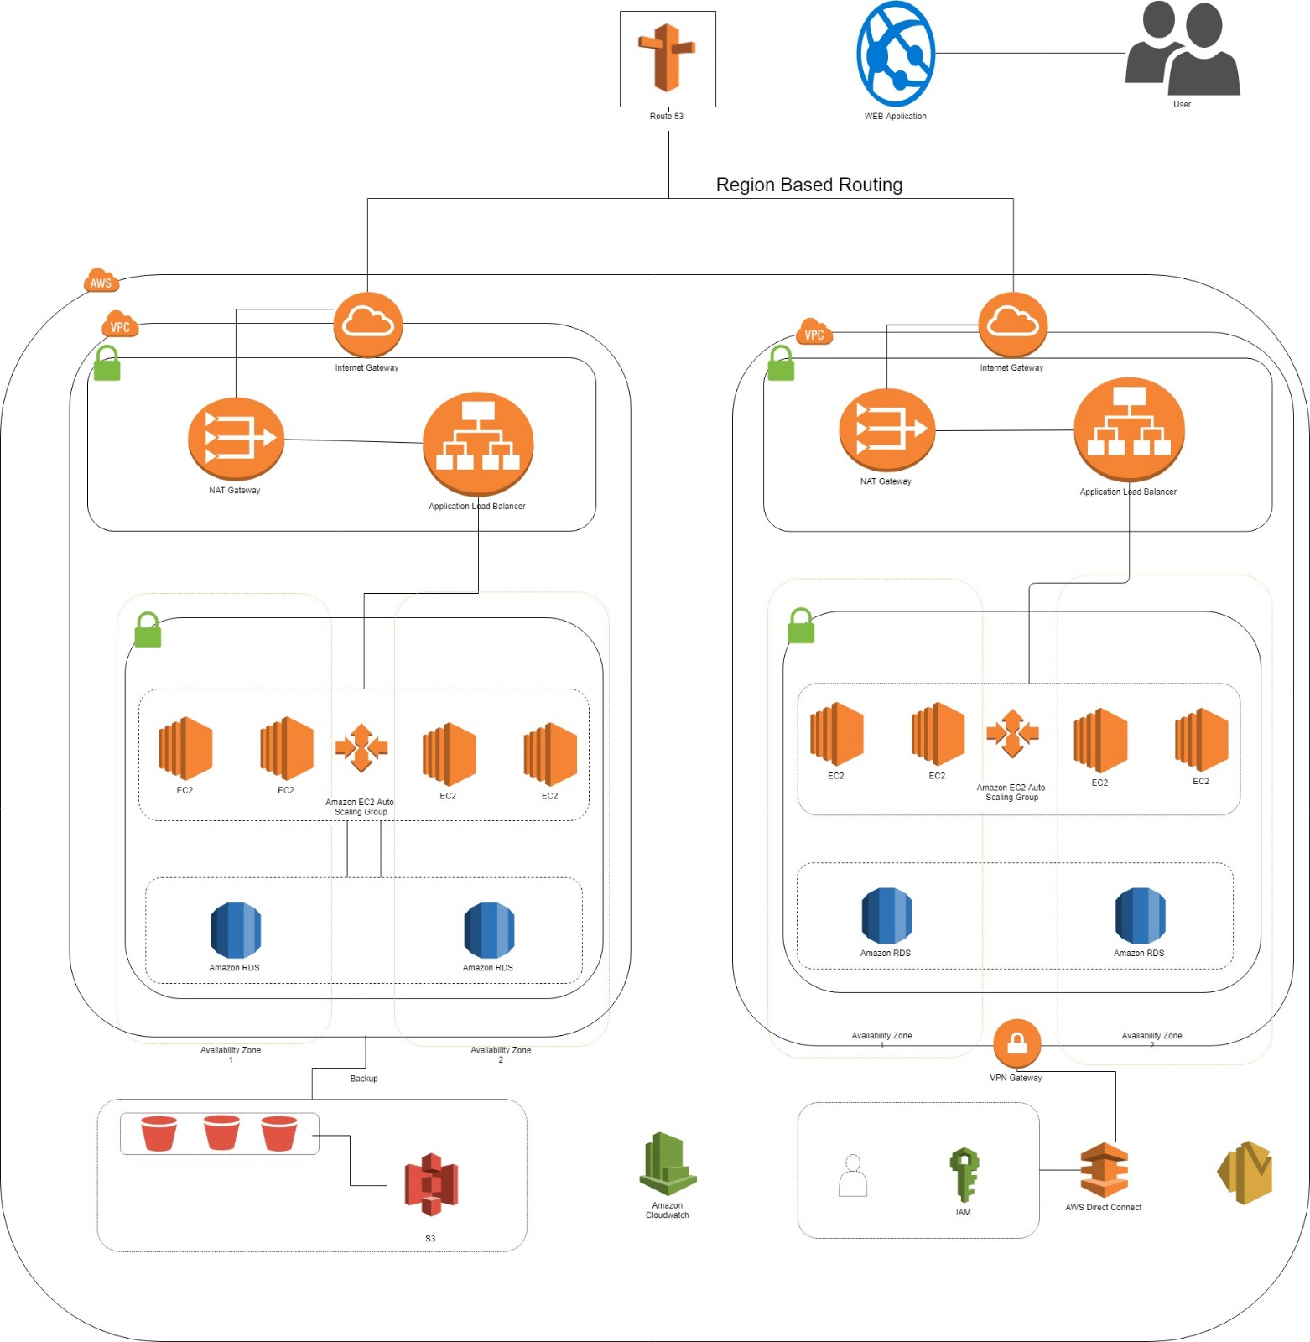
AWS Architecture

Slide 12
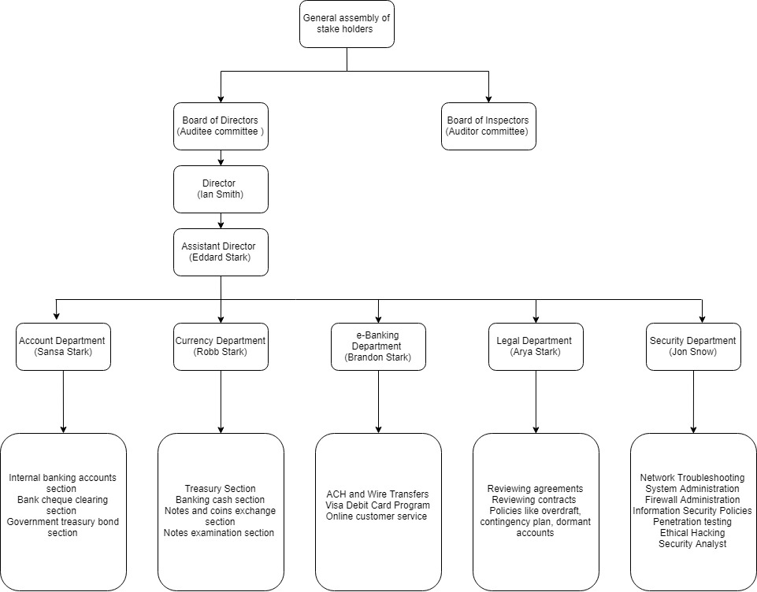
Organization Chart

Slide 13
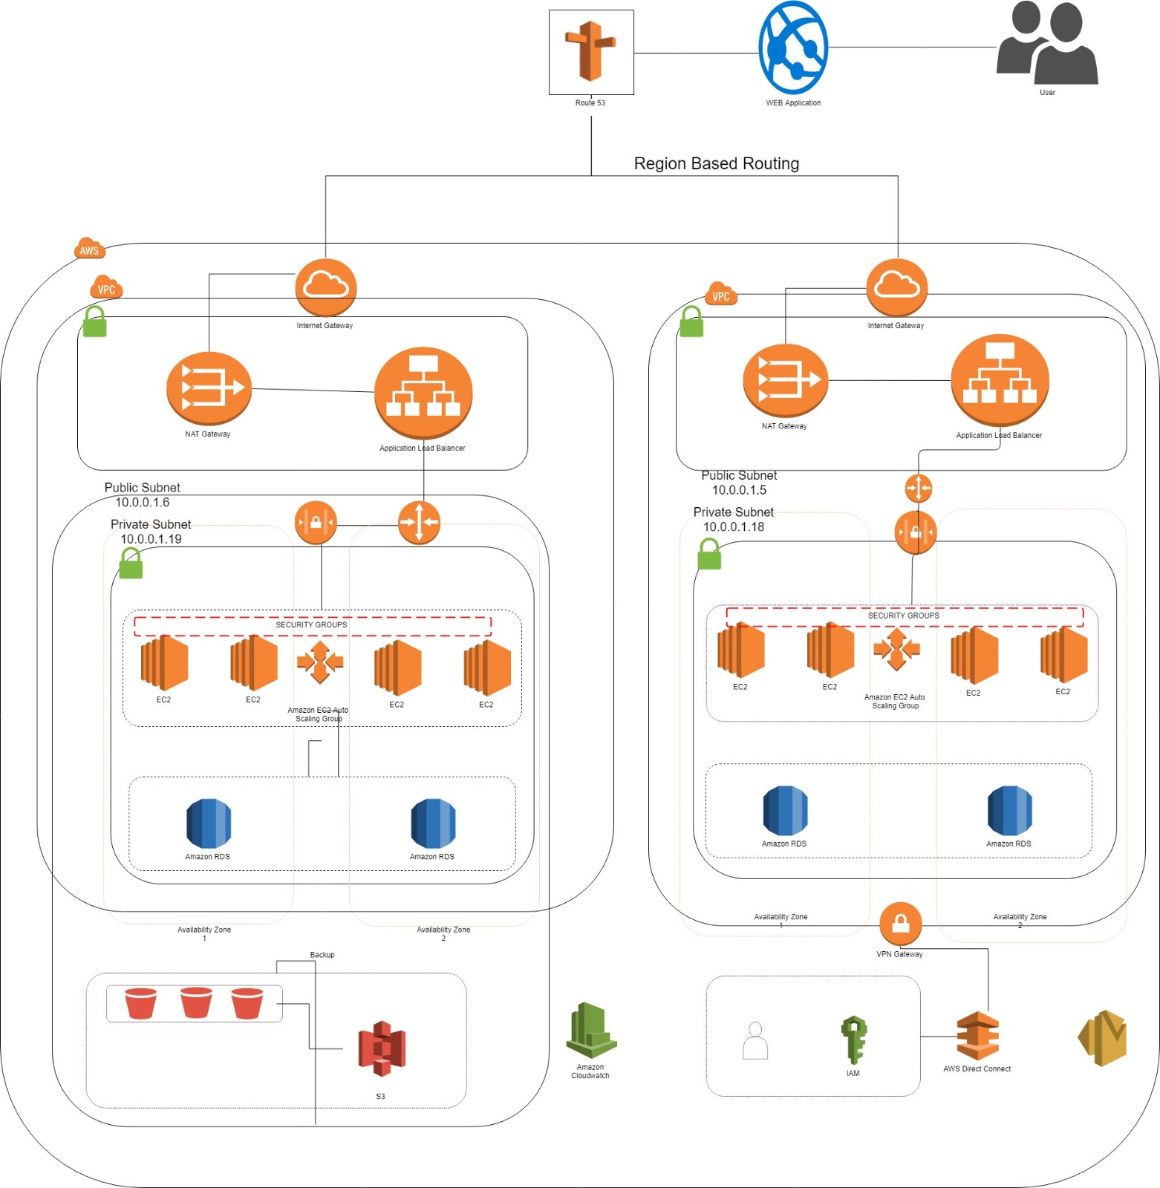
Network Architecture

Slide 14
Risk Based Audit Approach
This approach principally was performed by understanding company policies and procedures, guidance compiled with FDIC, FRB, FFIEC.
As auditors, we will then had to asses Data from the database information system on the network and the possible risk areas and material misstatement that possibly happened at Capital Jones
Once the risk areas were determined we designed an audit program and resources to detect those risks

Slide 15
Audit Program Steps
Step 1: Planning
First, we worked to understand our operations, internal controls and information systems. We then constructed an audit timetable together that meets our requirements.
1
Step 2: Risk assessment
Next, we used the knowledge gained from planning to assess our financial reporting risks. We then customized our audit approach to focus on business-critical areas.
2
Step 3: Evaluation of internal controls
Obtained understanding of internal controls and policies and procedures, along with an interview with assistant dean
3
Step 4: Audit Testing
Our team then used the help of the employees and software's used by the company to collect evidences to make sure all the criteria's in SOC are evaluated .
4
Step 5: Conclusion and Reporting
Lastly, we applied an additional check to ensure the accuracy of our work and to have enough evidences for our findings . We then turn the raw results into actionable insights.
5

Slide 16
Findings
Segregation of Duties
Disaster Recovery plans to be defined, tested and maintained
IT service recovery available only during office hours
ITDR plans invocation and mobilization is not defined sufficiently
A full ITDR test is has not been carried out
Lack of SLA and communication with the clients
Significant service desk issues occur in case of incidents

Slide 17
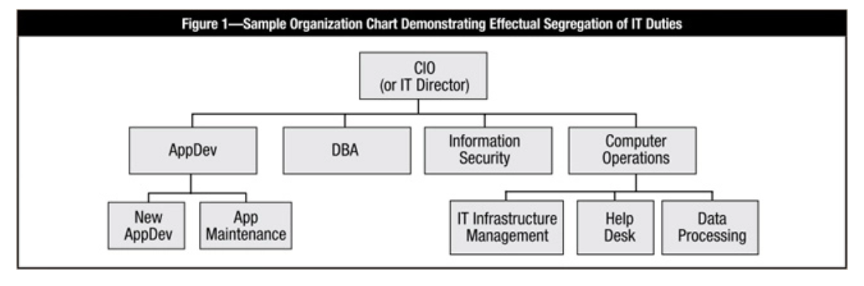
Recommendations
SoD for IT duties:
We recommend you refer the above organization diagram while assigning IT duties

Slide 18
Recommendations
2. ITDR Plan and Test
Extend out of office hours IT support
Extension of Disaster Recovery provision for critical services
Clarity and updates in IT Business Continuity Plan as to how MIM transfers responsibilities to it
En-masse recovery test to be implemented
3. Develop a catalogue of agreed service levels and document the SLAs

Slide 19
Conclusion
Although diligent and important efforts have been made over the past few years to get all processes in line and in compliance with all policies and regulations and to meet industry best practices; controls, processes and practices show significant areas in need for improvement. Johnson Yang has initiatives underway that are intended to address these deficiencies if carried through full agency support.

Slide 20

Thank You

